Slide 1
Mathematical and software tools for solving the problem of recognition of textured images areas using fractal analysis
Ministry of Science and Education of Ukraine
NTUU Kyiv Polytechnic Institute
Department of Applied Mathematics
Stankevych Mariia
Bachelor Thesis Defense Presentation
Kyiv 2016

Slide 2
Subject field. Image processing
Image processing is processing of images using mathematical operations by using any form of signal processing for which the input is an image, a series of images, or a video, such as a photograph or video frame; the output of image processing may be either an image or a set of characteristics or parameters related to the image.
Digital image processing is the use of computer algorithms to perform image processing on digital images.
A digital image is a numeric representation of (normally binary) a two-dimensional image.

Slide 3
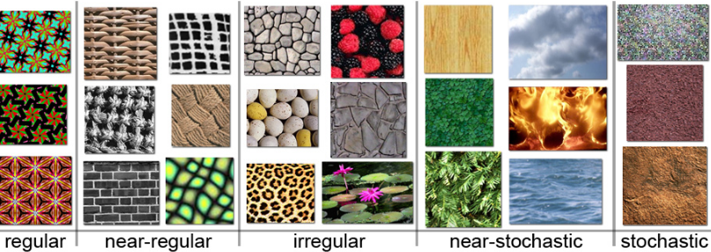
Subject field. Texture
The visual elements of image:
Point
Line
Shape
Texture
Color
A set of metrics calculated in image processing designed to quantify the perceived texture of an image.
Gives information about the spatial arrangement of color or intensities.
Texture can be defined as an entity consisting of mutually related pixels and group of pixels.

Slide 4
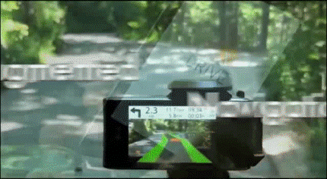
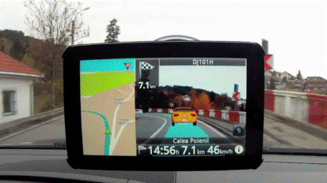
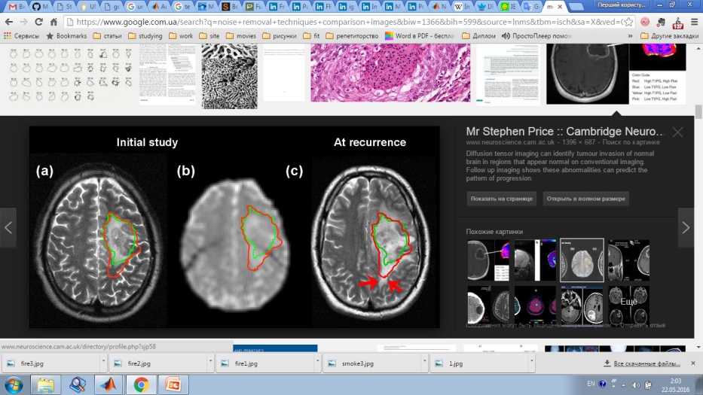
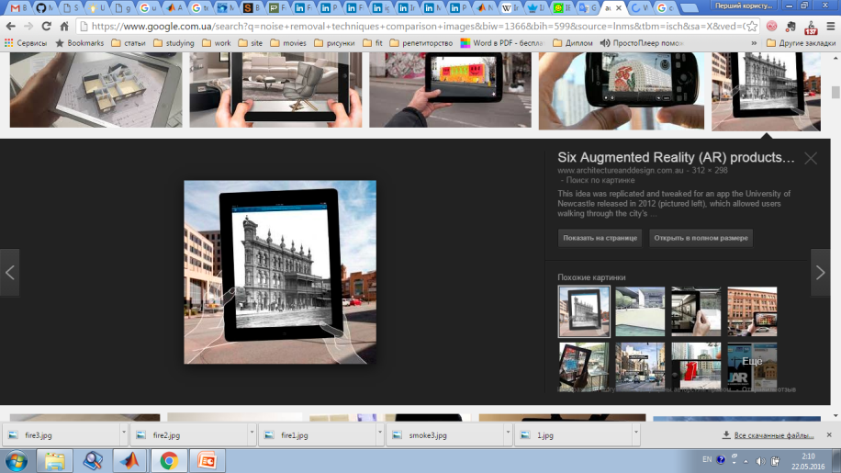
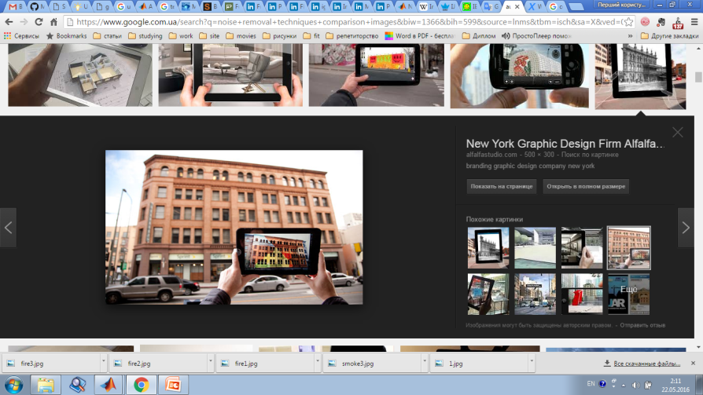
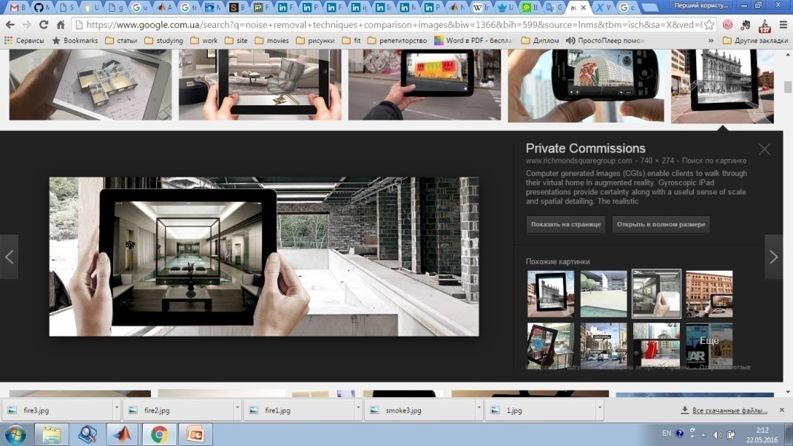
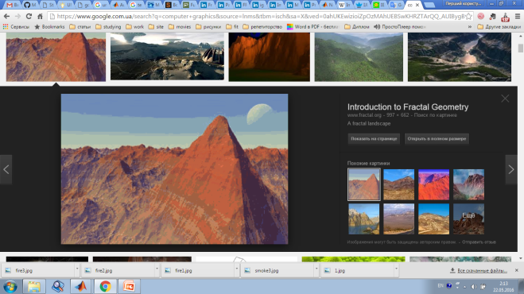
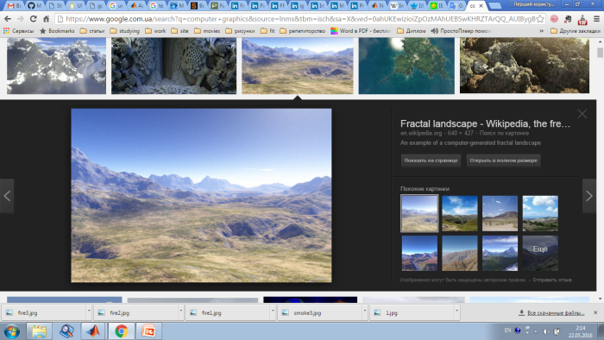
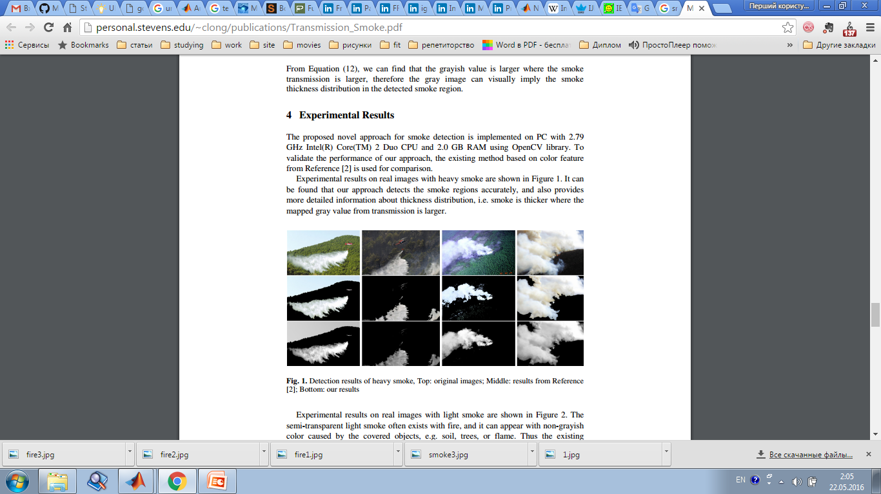
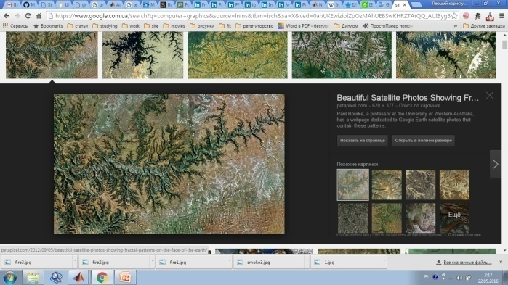
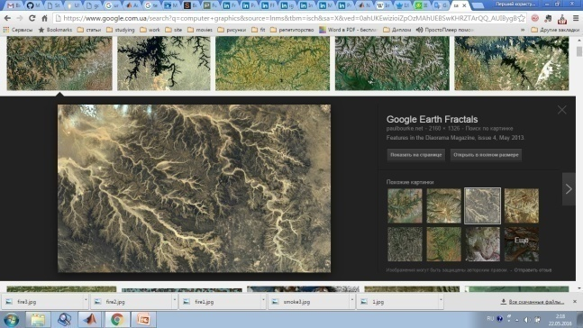
Actuality
Comfort
AR
Safety
Driving
Computerizing process
Finding tumor on early stages
Medicine
Architecture & Design
Visualization
Easy modeling
Computer graphics
Realism
Easy development
Smoke detection
Computerization
Safety
Satellite photos analysis
Research

Slide 5
Formulation of the problem
Object of the study: images, video
Subject of the study: texture analysis
Purpose of the study: to build road border by texture analysis of an image or a video that contains highways.
Input data:
an image or a video, containing the highways;
image formats: jpg, png;
video format: avi;
image size: 40*40 pxls – 1200*1200 pxls;
video duration: 2s – 15 minutes.
Results:
an image or a video, containing input image with built by algorithm highway borders;
image format: jpg;
video format: avi.

Slide 6
Tasks of the problem solving
preprocessing of the input data
movement noise removal
partition video frame by frame
image conversion
image filtering
texture analysis
visualization of the results obtained

Slide 7
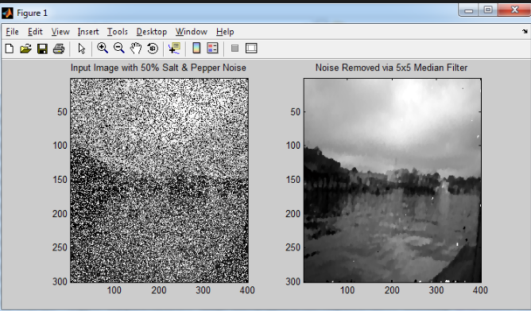
Analysis of existing solutions. Noise removal
Image noise is random (not present in the object imaged) variation of brightness or color information in images, and is usually an aspect of electronic noise.
Types of noise:
Gaussian noise
Salt and pepper noise
Poisson noise
Speckle noise

Slide 8
Analysis of existing solutions. Noise removal
Method | Applications | Advantages | Disadvantages
Median filtering | Computer vision | without reducing sharpness relatively light blurring good at removing salt and pepper noise | not for high levels of noise
Wiener filter | Control systems, digital communication | noise smoothing and inverse filtering. | blurs an image
Adaptive filter | Mobile phones, cameras, medical monitors | many well documented implementations are optimal in that they minimize the mean squared estimation error can be computed in real-time | assume that process dynamics are linear provide a point estimate can only handle processes with additive, unimodal noise
Anisotropic filter | 3D graphics | preserves the edges of the object. reduces noise in higher region. | has low speed – not for online implementation
Wavelet transform | signal processing of accelerations for gait analysis, in digital communication | can achieve both noise reduction and feature extraction | accurate statistical description should be given uses threshold only for specific field will not work with different scale or orientation

Slide 9
Analysis of existing solutions. Texture analysis
Methods | Field of application | Advantages | Disadvantages
Statistical | Images with well known structure, with contrasting border | implementation ease high speed | too highly detailed segmentation high computational complexity the need for a preliminary study
Structural | Regular artificial images | importance is attached to the form of non-derivative tone elements. | doesn’t work with nature images
Spectral | Image of periodic and quasi-periodic two-dimensional structures | descriptions of orientation the partial information on non-derivative elements | there is considerable overlap of the spectra for regions with markedly different natural textures
Fractal | Images with natural surfaces | accounts nature of surfaces detection of artificial changes | doesn’t build a global fractal model of the entire image high labor intensity

Slide 10
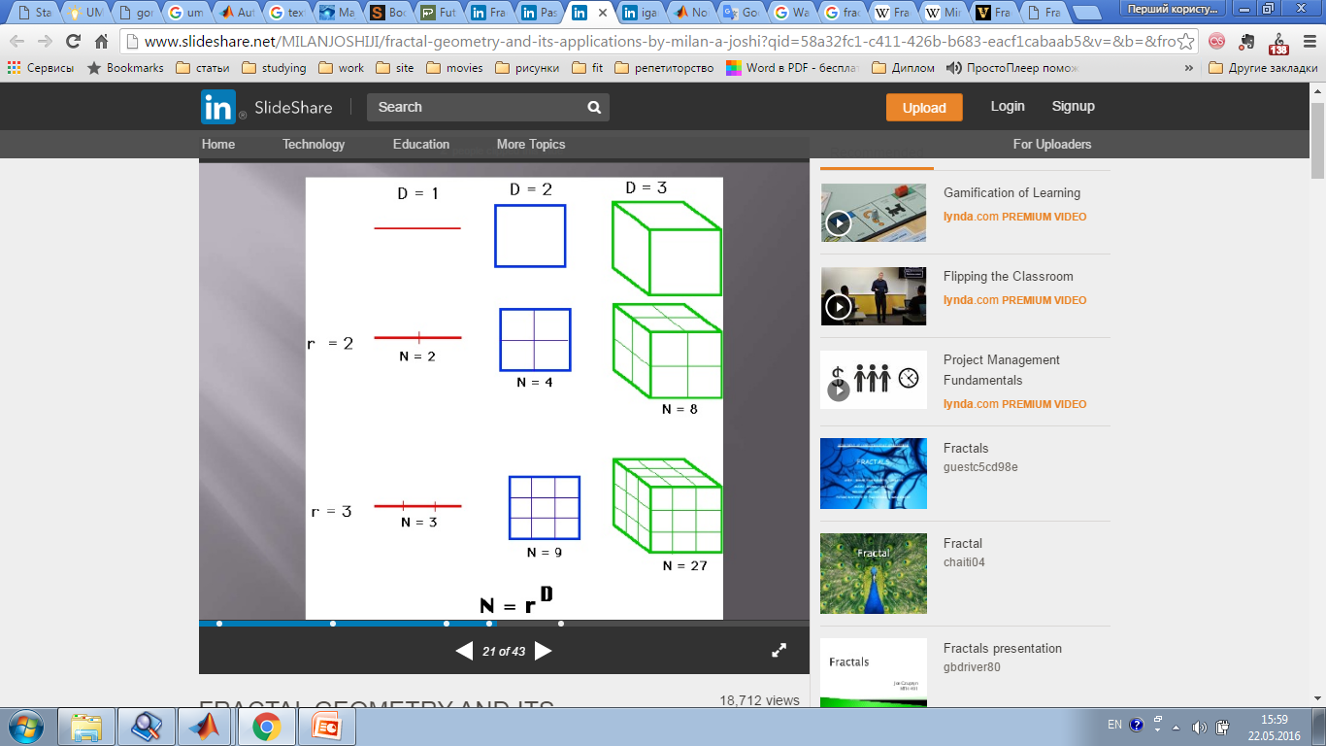
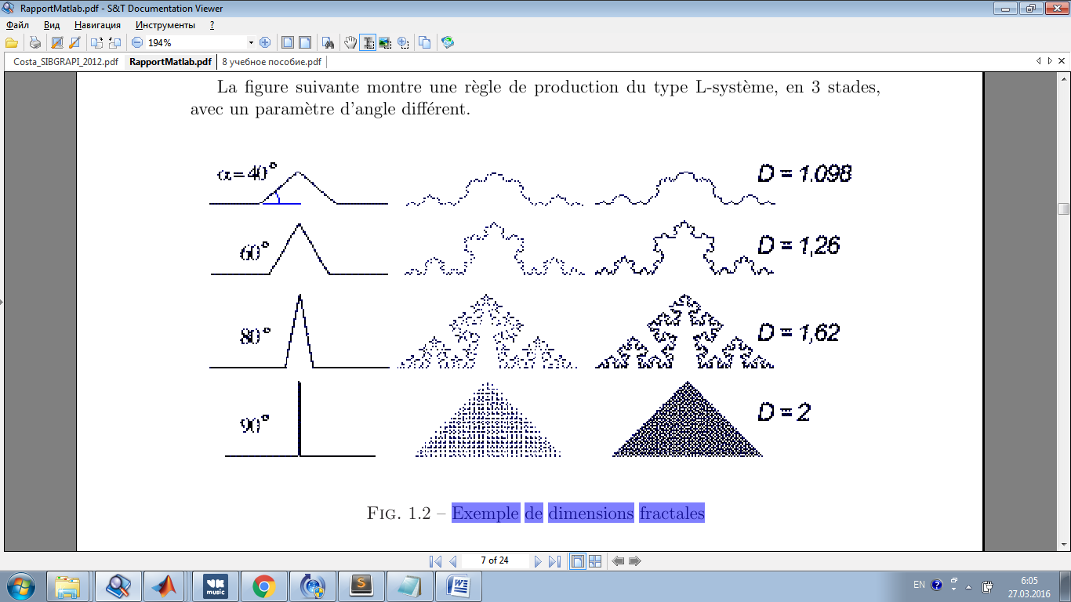
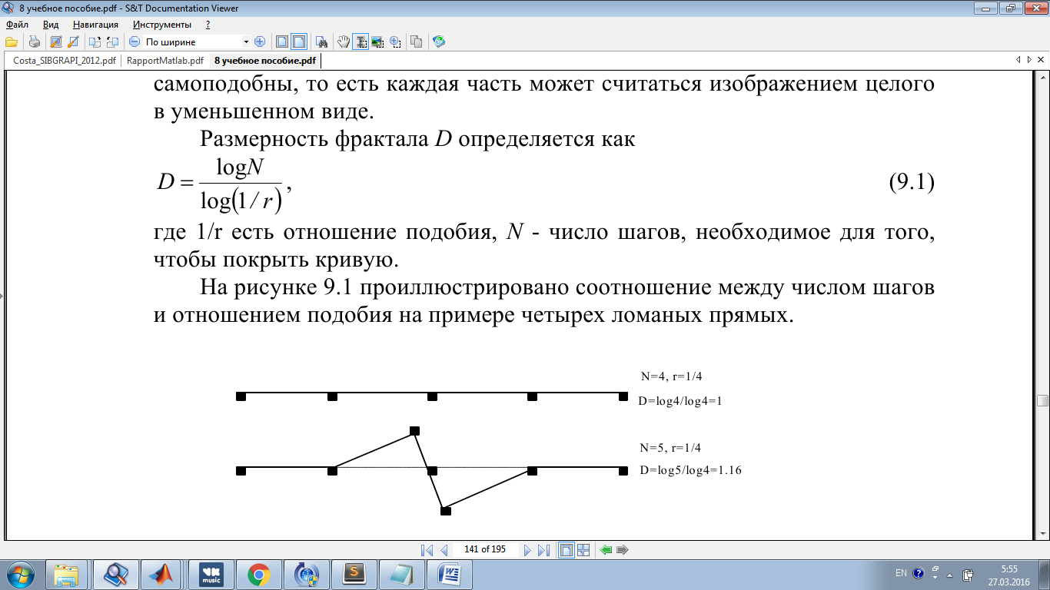
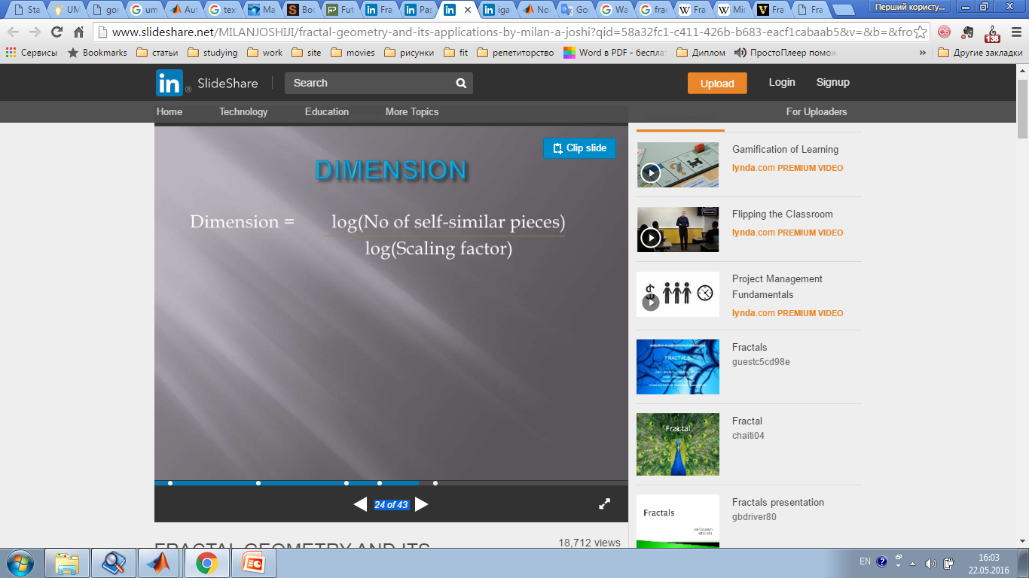
Fractal Segmentation. Fractal Dimension
A fractal is a natural phenomenon or a mathematical set that exhibits a repeating pattern that displays at every scale.
Fractal dimension is a ratio providing a statistical index of complexity comparing how detail in a pattern (strictly speaking, a fractal pattern) changes with the scale at which it is measured.
Hausdorff dimension

Slide 11
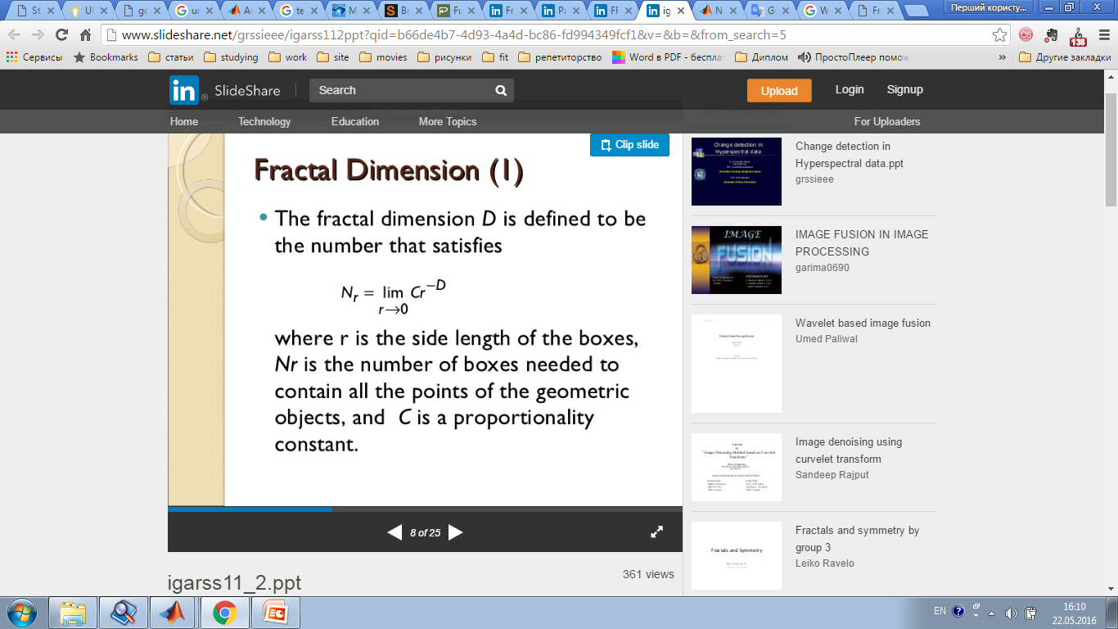
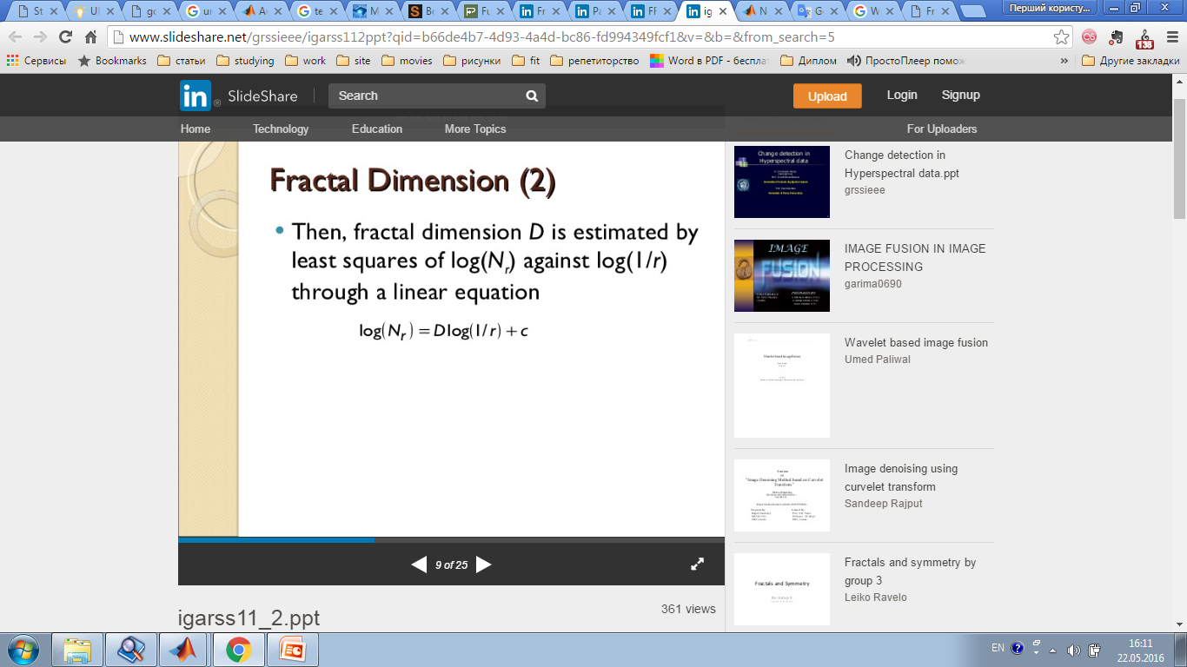
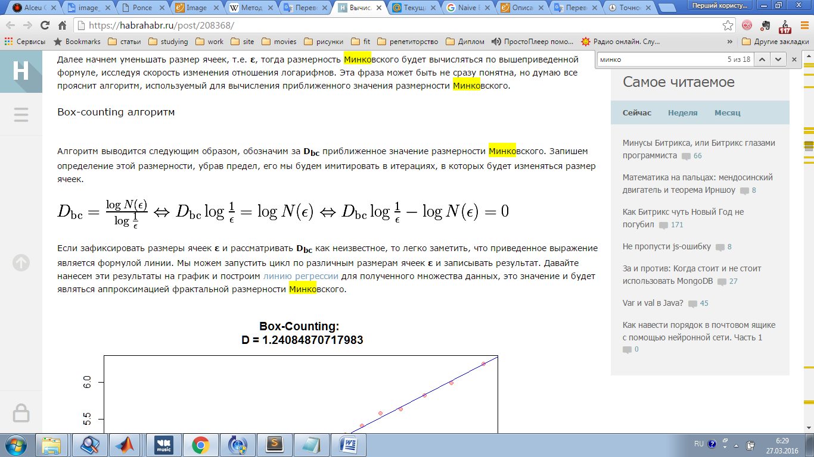
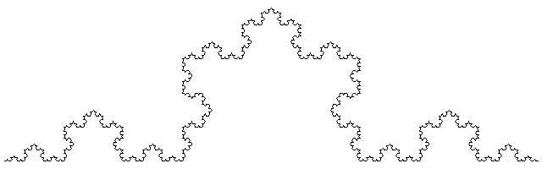
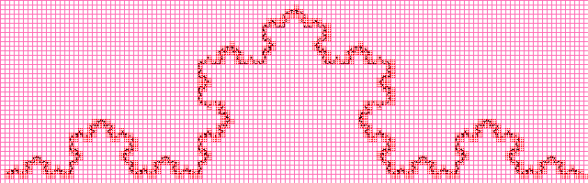
Fractal Dimension Estimation
The fractal dimension D is defined to be the number that satisfies:
Where r is the side length of the boxes, Nr is the number of boxes needed to contain all the points of the geometric objects, and C is a proportionality constant.
Then, fractal dimension D is estimated by least squares of log(Nr) against log(1/r) through a linear equation:
Box-counting dimension

Slide 12
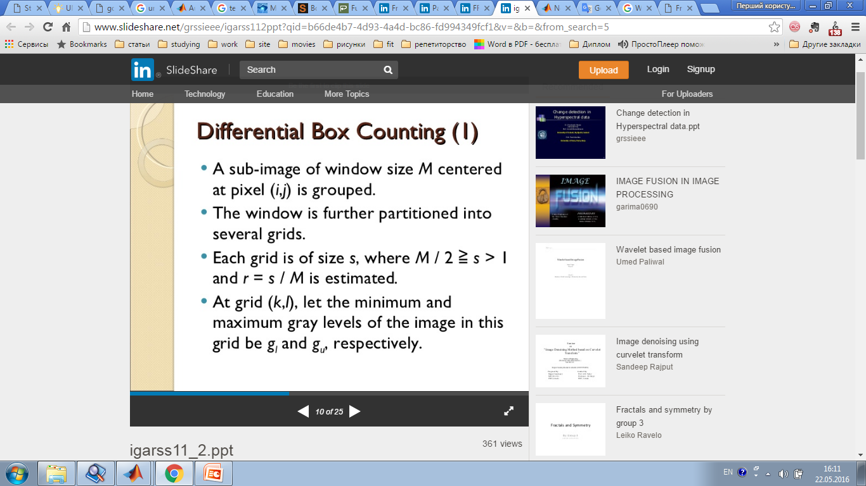
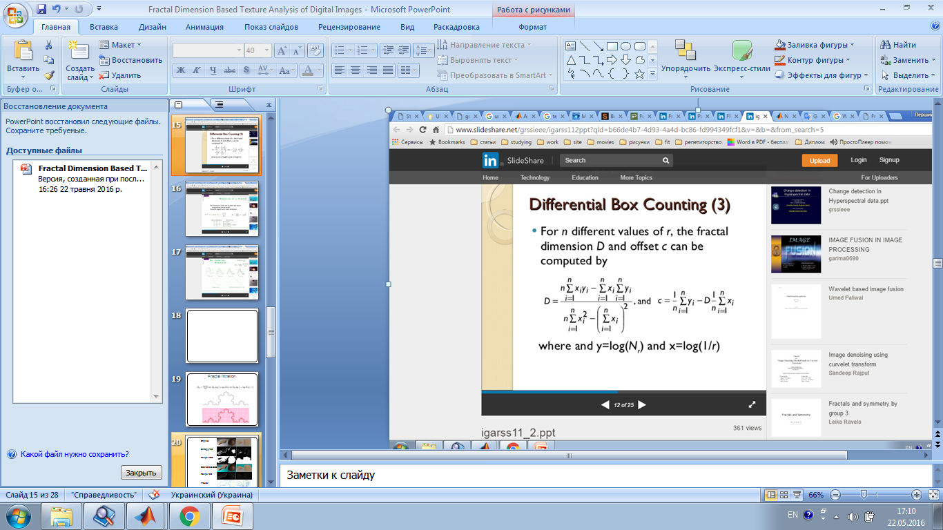
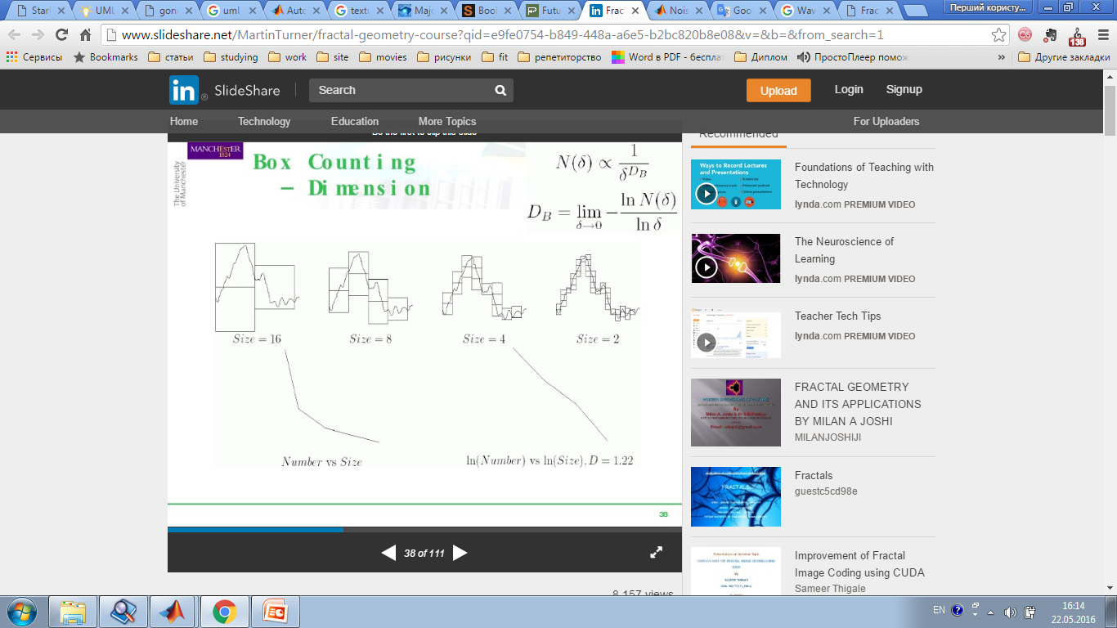
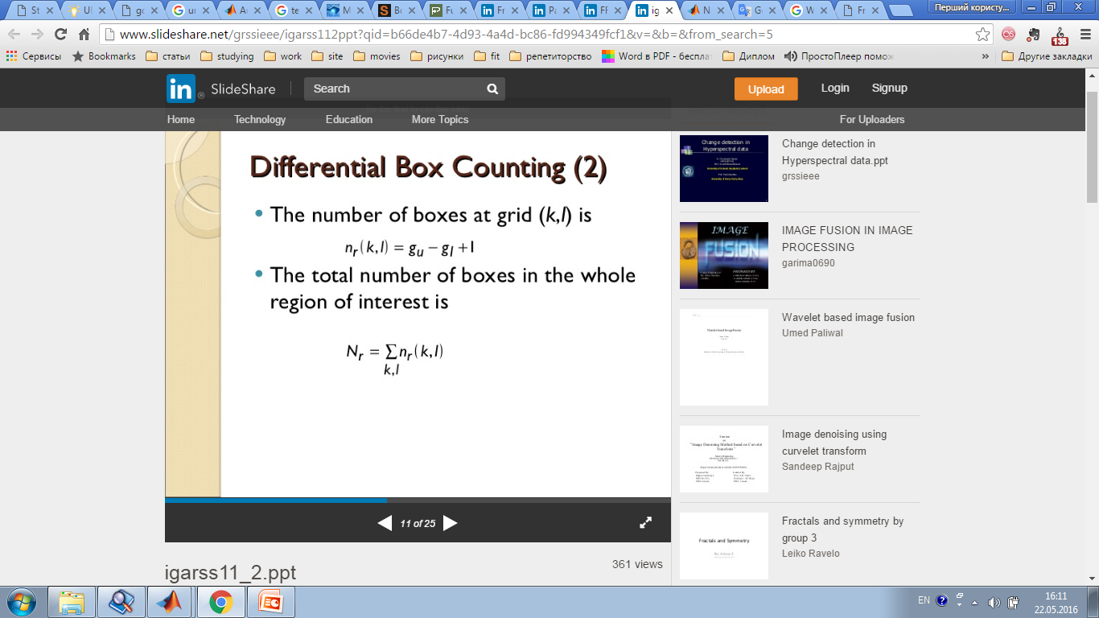
Fractal Segmentation. Differential box-counting

Slide 13
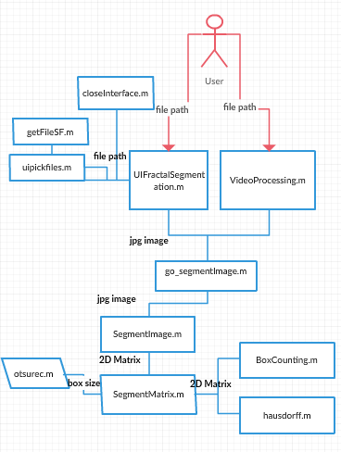
Software architecture
1. Opening of the image.
2. Convert the image to grayscale (if the image is in color).
3. Apply a gradient filter.
4. The threshold binarization image.
5. Calculation of segmentation on the edge.
6. Application BoxCounting algorithm on the selected region.
7. Construction of associative matrix fractal dimensions.
8. Display outlines areas in which the fractal dimension is relatively important.

Slide 14
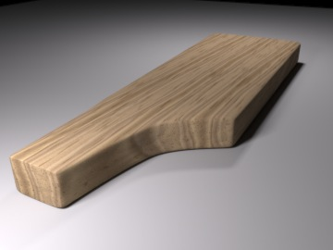
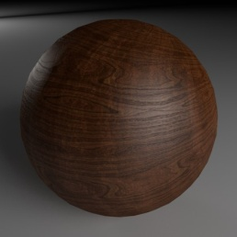
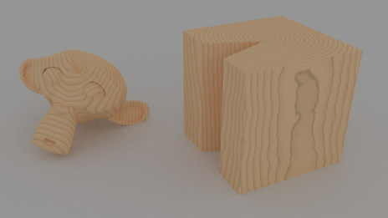
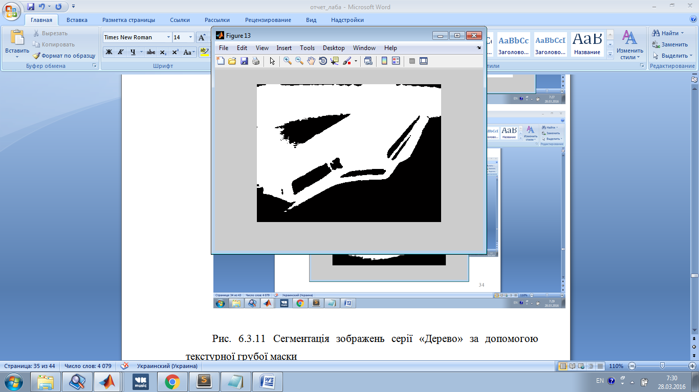
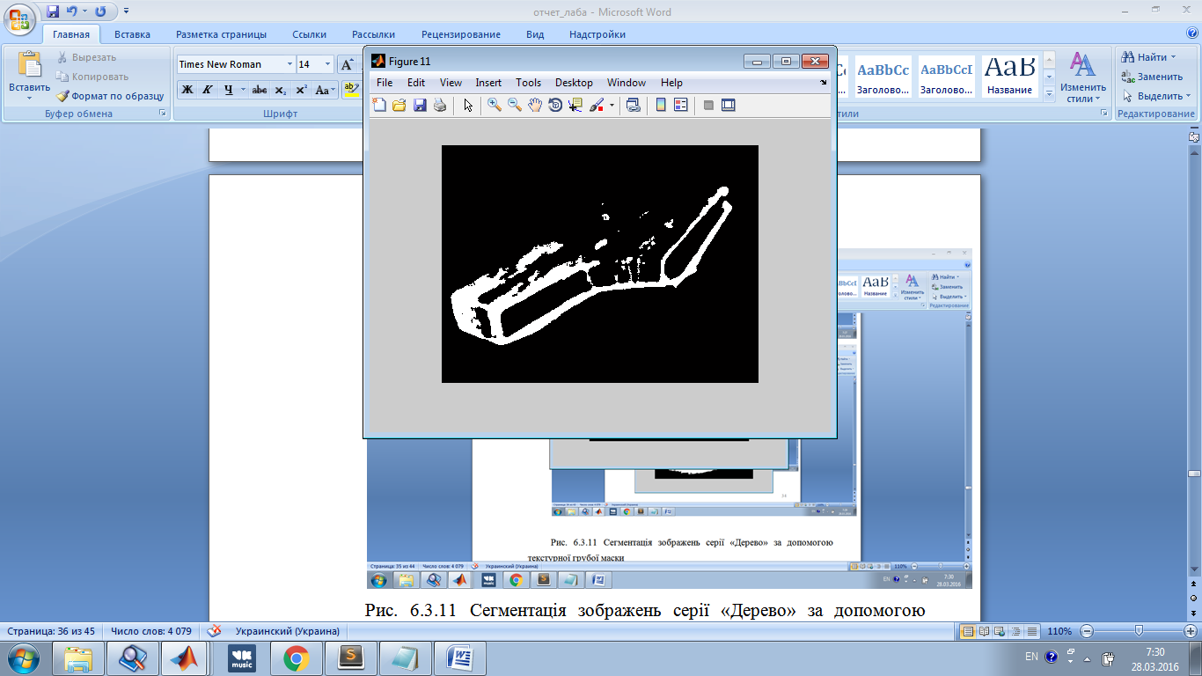
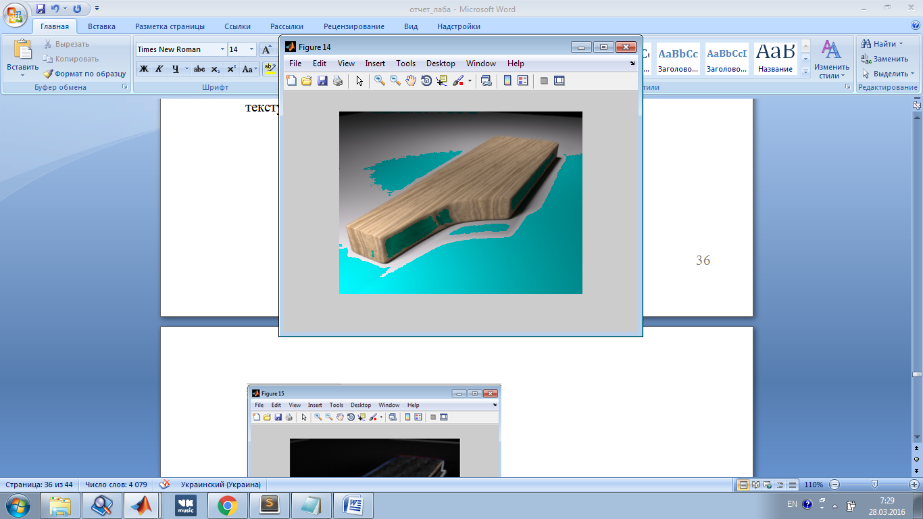
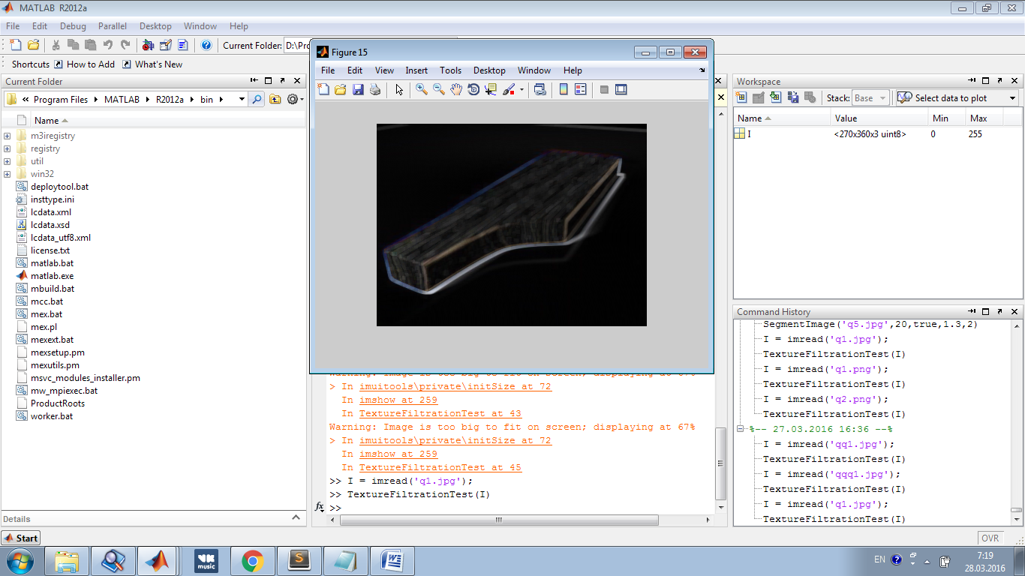
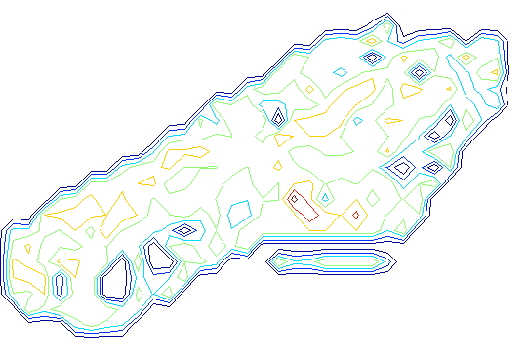
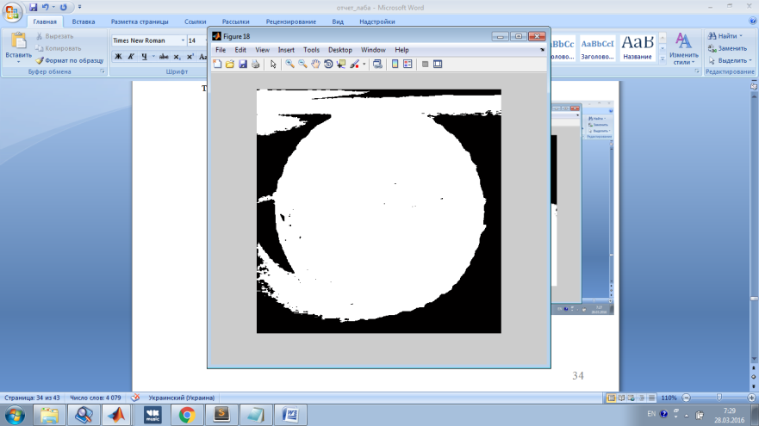
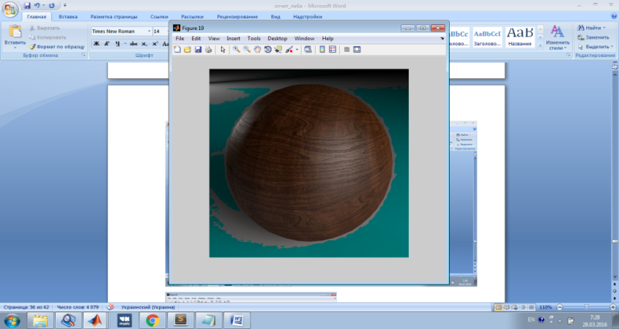
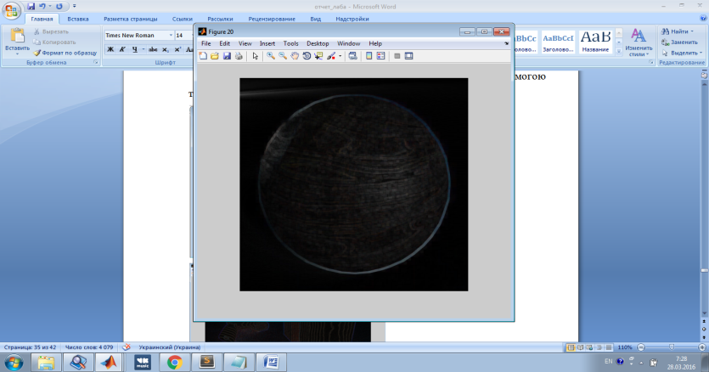
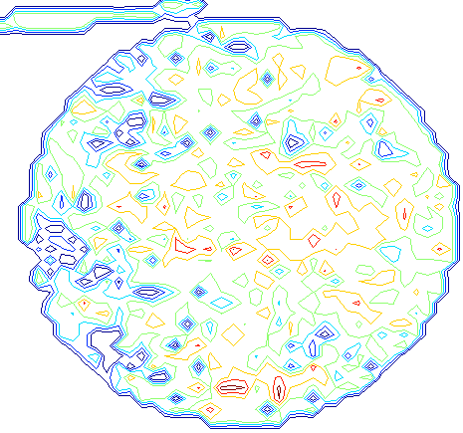
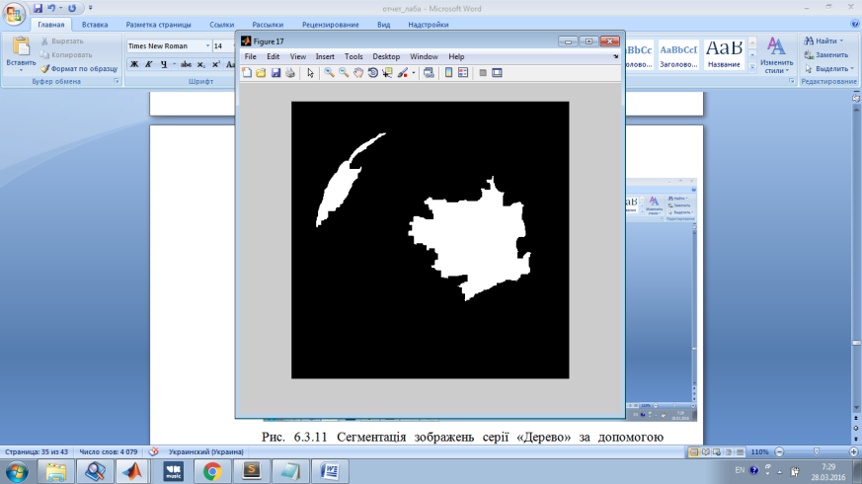
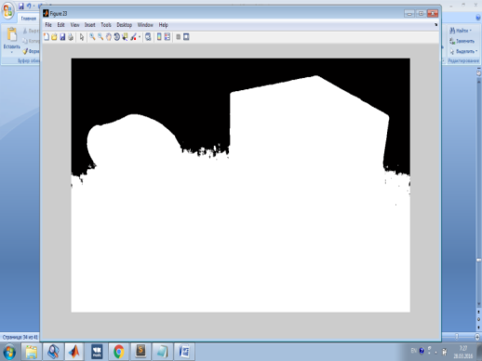
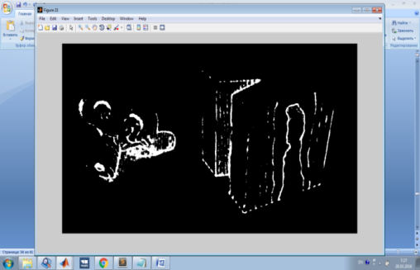
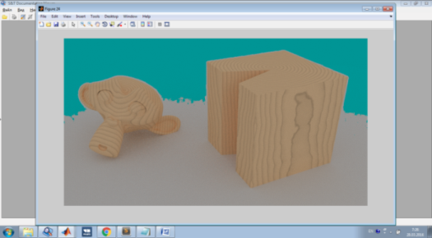
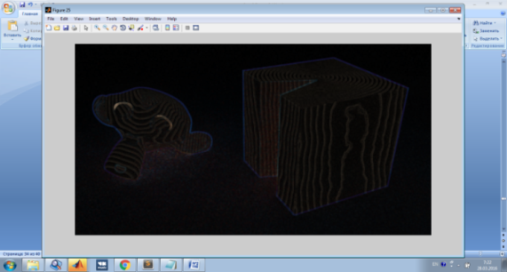
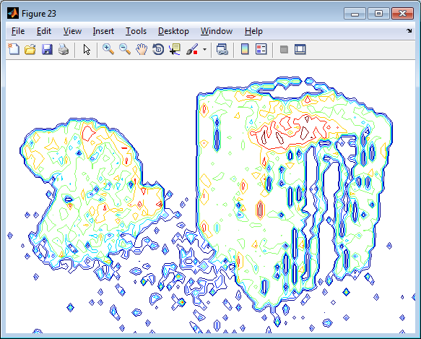
Texture analysis. Methods comparison
Original
images
Rough mask
Entropy filter
Standard deviation
Range filter
Fractal

Slide 15
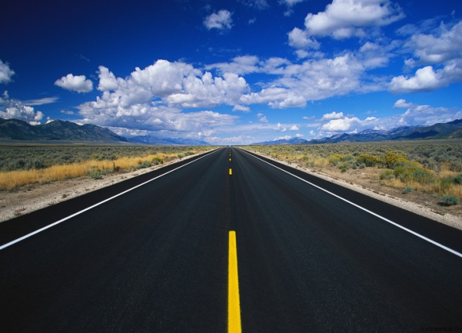
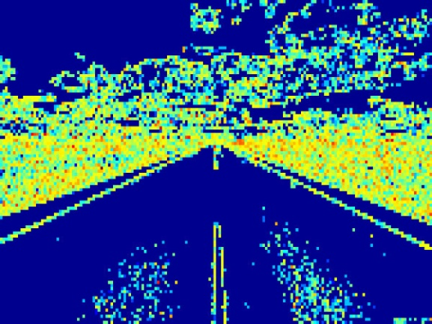
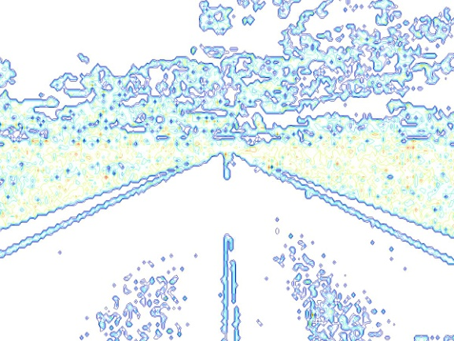
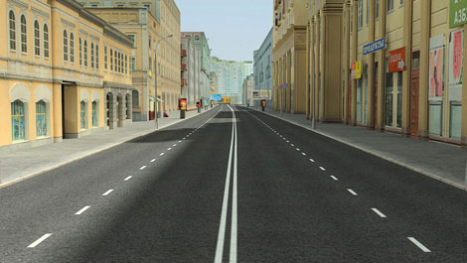
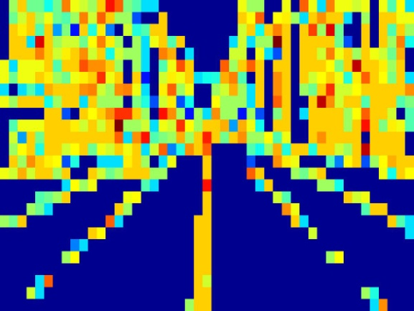

Texture analysis. Static objects
Grid view of fractal segmentation
Contour line of fractal function
Original image

Slide 16






Texture analysis. Static objects
Grid view of fractal segmentation
Contour line of fractal function
Original image

Slide 17




Texture analysis. Dynamic objects
Original video
Result video
Grid video
Contour video

Slide 18




Texture analysis. Dynamic objects
Original video
Result video
Grid video
Contour video

Slide 19
Conclusion
Considered problem: the recognition of the limits of roads for static and dynamic images of highways
Chosen implementation method: fractal texture segmentation using the dimensions of Hausdorff and Minkowski.
The test results of implementation on test examples show that the method is able to identify accurately the coast road on images of varying quality and made even at night.
Further expansion of the system: to implement training system using neural network.

Slide 20
Thank you for your attention!

